Slide 1
Public Health Data Model (JHU Daily Reports and American Community Survey)
By: Alay Shah and William Connell

Slide 2
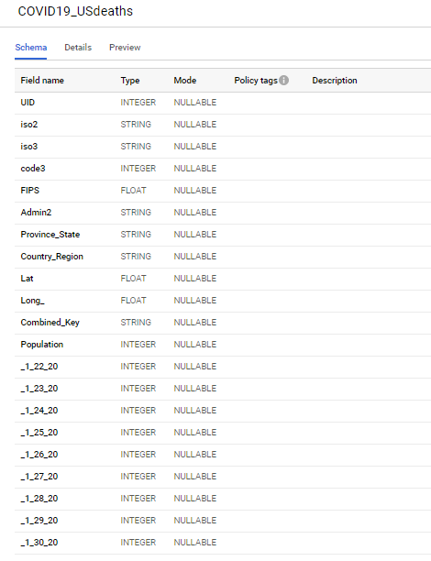
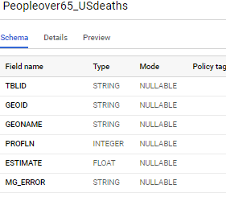
Datasets
Primary Dataset:
COVID19_USDeaths
Source:
JHU Daily Reports
Schema:
Auto-Schema
Project Work:
Imported files into staging tables
Secondary Dataset:
PeopleOver65_USDeaths
PeopleOver85_USDeaths
Source:
US Census Bureau
Schema:
Auto-Schema
Project Work:
Imported files into staging tables
Challenges (Is there a relation between these two datasets, and entities or attributes?)
Dataset attributes related to (Geography), narrowed down to US and choose CSV files from US Bureau that gave us mortality measures
Questions:
Does COVID19 deaths and PeopleOver65/85 that have higher mortality percentages have similar overlapping regions?
Across major US Cities, does high population correlate to an increase of those affected by COVID and those people over 65/85 that have high mortality percentage?

Slide 3
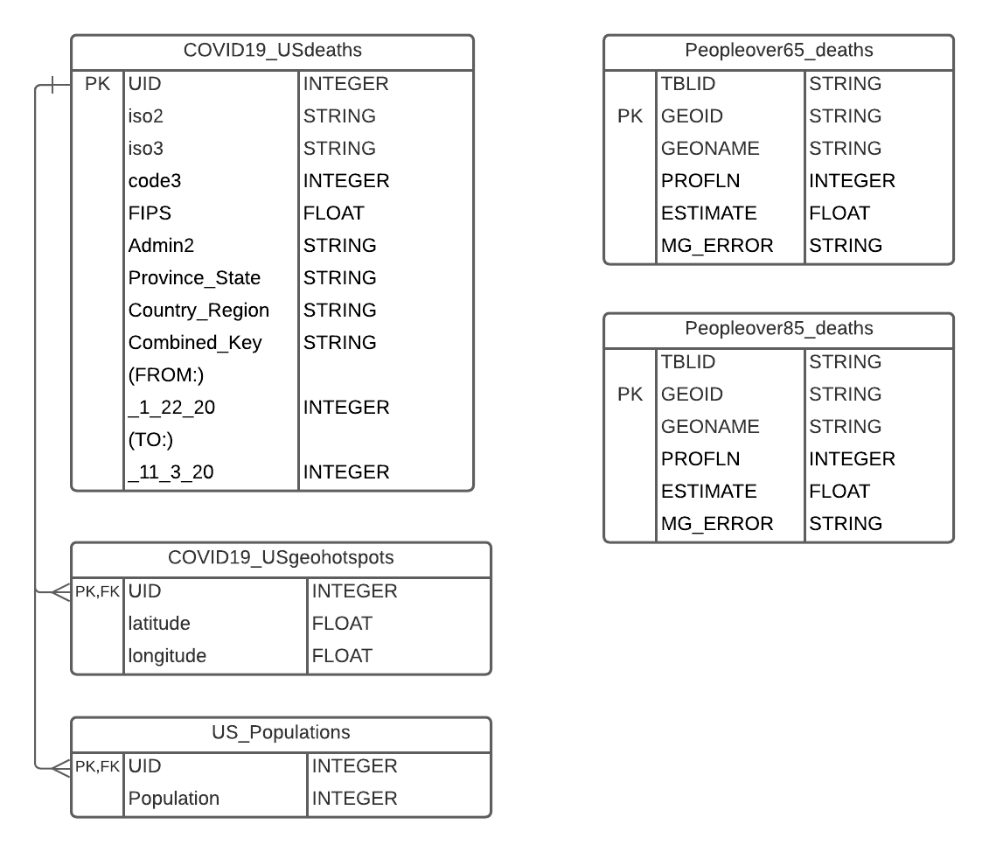
Milestone 2 - Modeled Schema
Split staging tables that contained more than 1 entity into separate tables
Enforced Referential Integrity
Continued to explore data with SQL queries
Working demo: Splitting COVID19_USdeaths and Aggregated (Correlated) Subquery
Notes:
Show code of Splitting tables , Show 4th subquery

Slide 4
Milestone 3 - Beam Pipeline
Ran two beam pipelines to cleanse non-conforming data
(Quick run through of code)
https://github.com/cs327e-fall2020/utbeemers/blob/master/PeopleOver65_beam.py

Slide 5
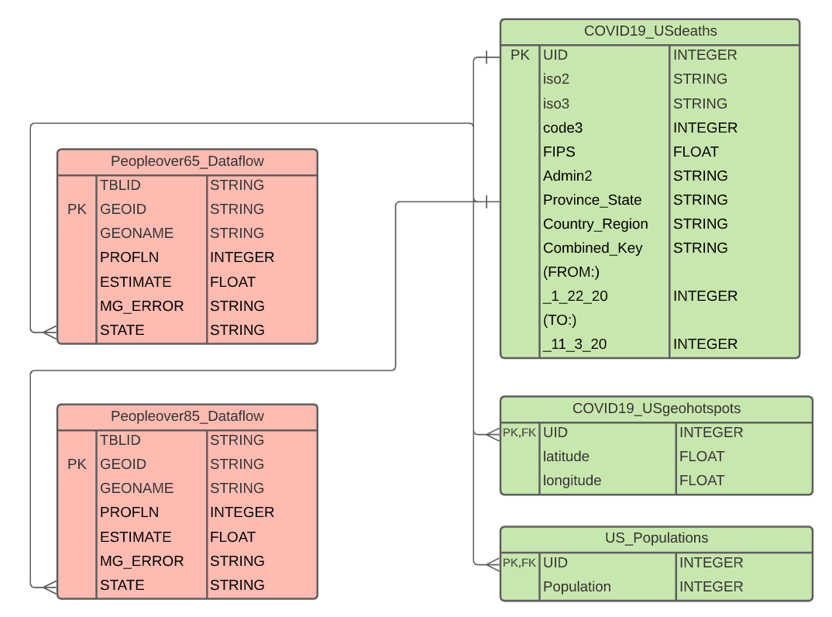
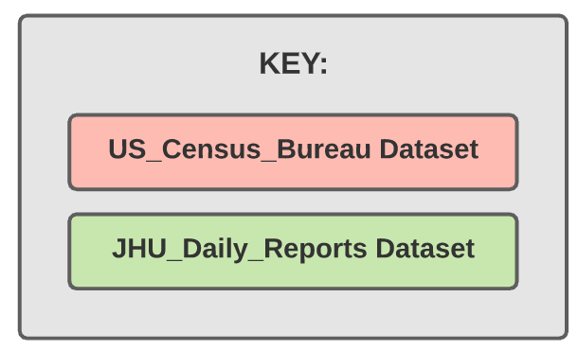
Milestone4 & Unified Data Model

Slide 6
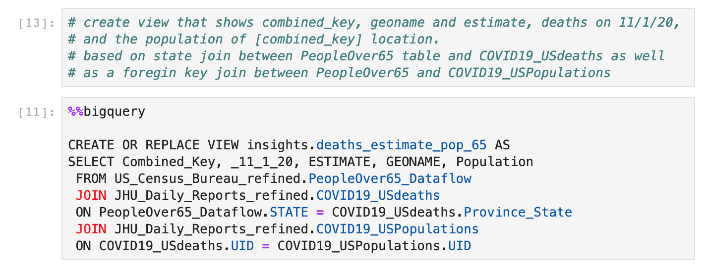
Cross Dataset Query
Working demo (Showing all 3 Cross Dataset Queries Running)

Slide 7
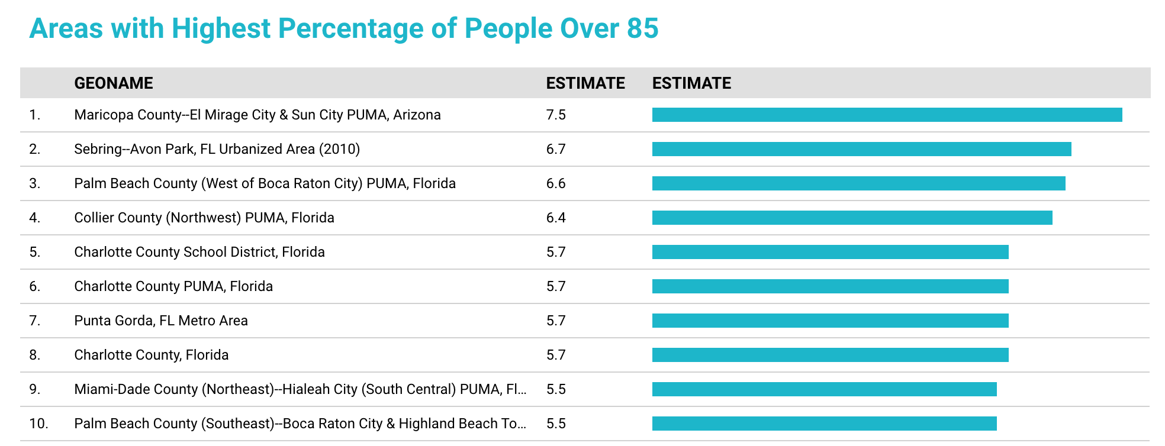
Data Reports
Notes:
Highlight accomplishments

Slide 8
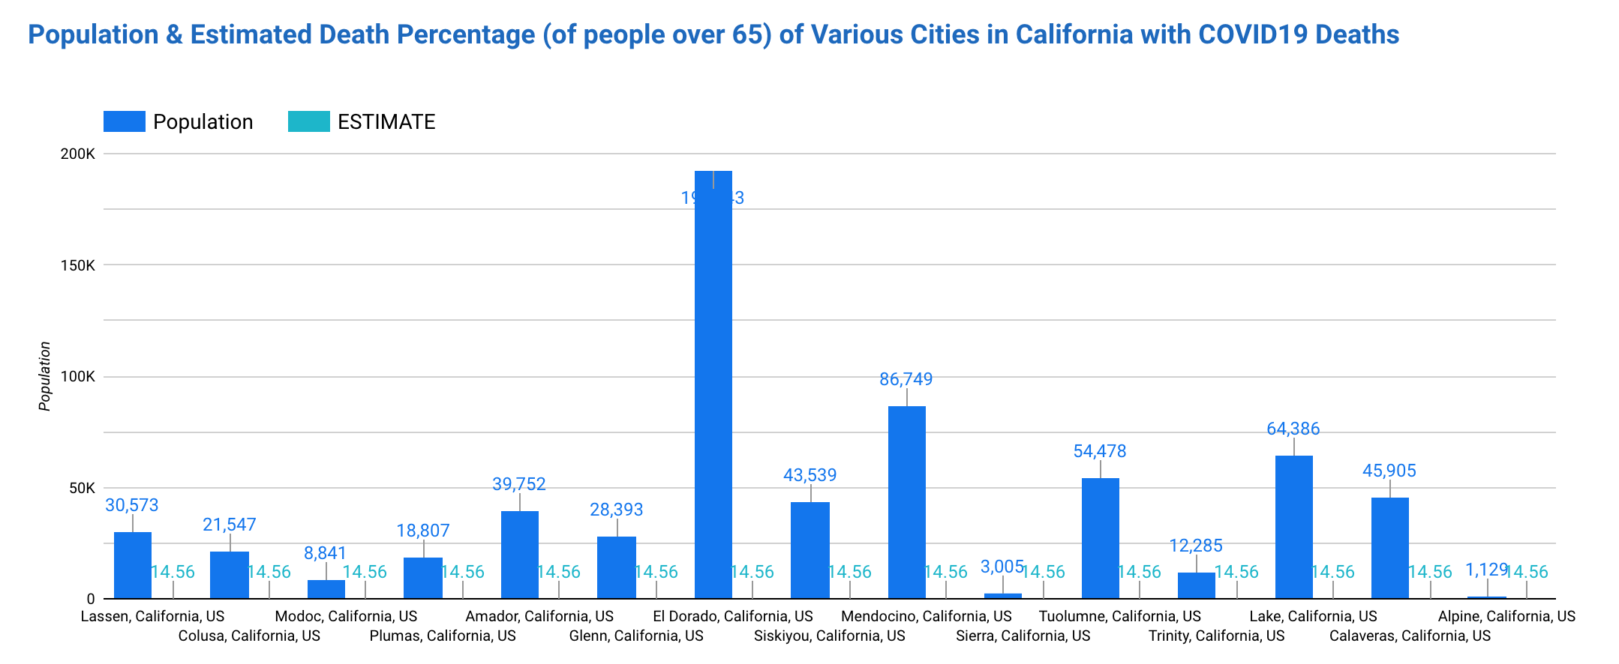
Data Reports (Cross Dataset)

Slide 9
Problems Encountered & Future Improvements
Choosing more compatible data from the start (counties vs. cities)
Geography formatting and information was inconsistent between datasets
COVID19_USDeaths: Combined_Key (County, State) format
PeopleOver65/85_USDeaths: Geoname formatting was inconsistent across the records, had to extract State using formatName in Beam

